Slide 1
Muggie maggie
By beverly cleary
Dmiyah Hannah

Slide 2
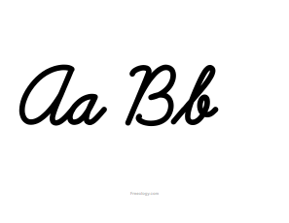
Chapter 1
Maggie love to write in cursive although her cursive write writing was messy.

Slide 3
Chapter 2
Mrs Leeper was whispering with the other teachers in the hallway maggie tried to be invisible so they wouldn’t talk about her no one in the class paid any attention to her.

Slide 4
Chaper 3
Ms. Madden brought maggie a present it was a blue and red ink pen maggie felled in love with her new present.

Slide 5
Chapter 4
Maggie is not bored anymore with her cursive writing she was talks to her friends at lunch now.

Slide 6
Chapter 5
She jumped off the bus while saying bye bye to her friend and some boys was calling maggie name.

Slide 7
Chaper 6
Maggie was busy monitoring messages for mrs. Leeper going to room to room and even going to the library mrs. Leeper wanted her to hurry up.

Slide 8
Chaper 7
The third grade class monitors led the salute to the flag they got alot accomplished that day and mrs. Leeper was very proud of them.

Slide 9
Chapter 8
Maggie was reading and cursive now her dad was happy for her.

