Slide 1

Socks
By Beverly Cleary
Presentation by Kathryn Keyser

Slide 2
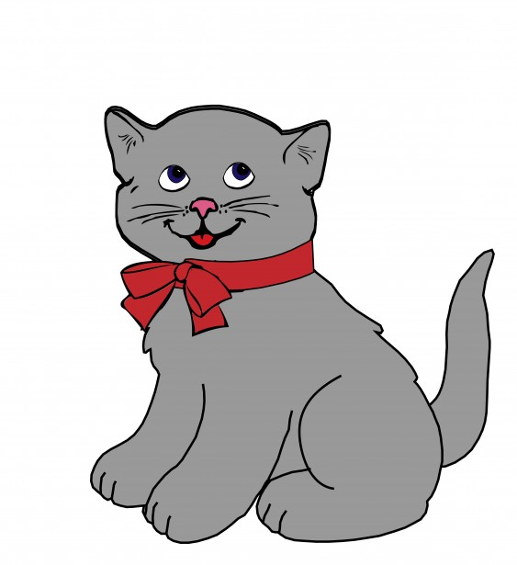
Chapter 1
Everybody wanted Socks.An eldery womon walked up and saw the kittens.The kittens where 25 cents.

Slide 3

Chapter 2
The Brickers brought a baby home.Socks is in the corner wanting for milk.Socks tried to get his peg pog ball.

Slide 4

Chapter 3
Socks came out of the hat. Socks climbs under the chair. The house was filled with lint.

Slide 5
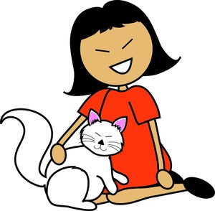
Chapter 4
An elderly woman pet Socks. A little girl saw Socks. The little girl was happy to see Socks.

Slide 6
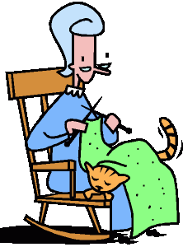
Chapter 5
Socks get’s a visit from Nana. Mrs. Bricker spent cleaning. Socks git’s thrown out.

Slide 7

Chapter 6
Socks and a black cat got in a fight. Old Taylor sprayed Socks. The black cat was to much for Socks.

Slide 8

Chapter 7
The babys bottle spelled on the floor. Socks ripped the little girls toy. The baby tries to get Socks.

