Slide 1
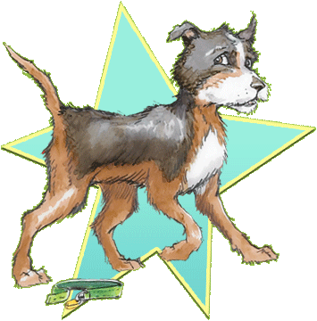
Ribsy
By Beverly Cleary
Presentation by Katherine Newman

Slide 2
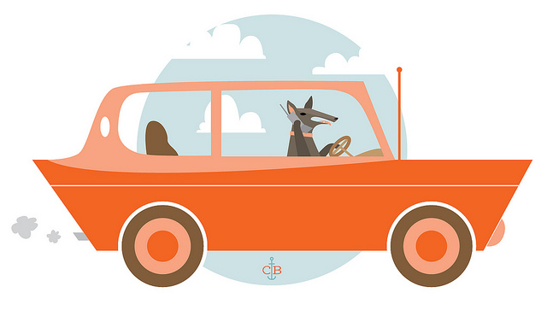
Ribsy and the hungry flea
Ribsy had a mean hungry flea on him.
Henry was Ribsy,s best friend.
His family took him to the shopping center and he got lost.

Slide 3
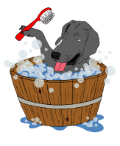
The cleanest dog in the U.S.A.
The Huggins looked for Ribsy but did not find him. Ribsy is in a different station wagon. The Dingley family gave Ribsy a bath.

Slide 4
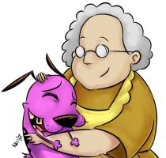
Ribsy and Mrs. Frawley
The Huggins were worried about Ribsy. Ribsy was wet and hungry. Ribsy found a home and stayed with a nice lady.

Slide 5
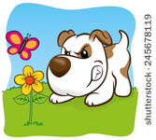
Ribsy becomes a Mascot
A man found Ribsy running on Broadway. Ribsy wanted to find a way to his home. Ribsy became a mascot.

Slide 6
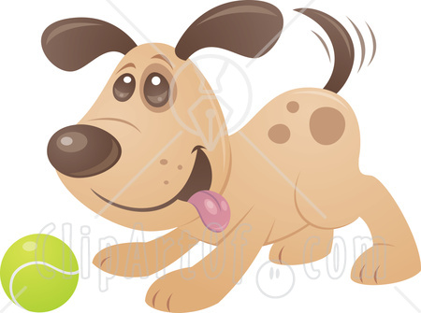
Ribsy Goes to a Football Game
The Huggins told Henry he was responsible. They thought that Ribsy was locked up but he was not. Ribsy got tackeld at the football game by a boy Henry’s age.

Slide 7
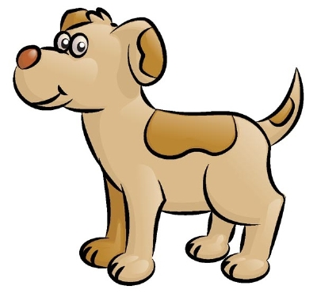
The Famous Dog
Henry was worried about Ribsy. Ramona told Henry to get a horse but he did not want to get one. Ribsy became famous

Slide 8
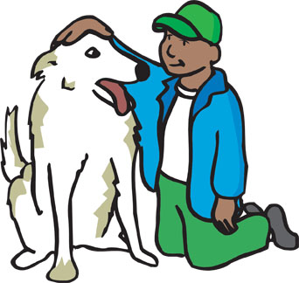
Ribsy and the Apartment house
The Huggins knew they were close to Ribsy in the apartment. Ribsy didn’t know where he was going and could not find Henry. Finally the Huggins found Ribsy.

