Slide 1

Beezus and Ramona
By Beverly cleary
Presentation by jayden cline

Slide 2
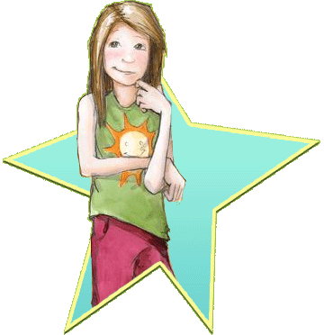
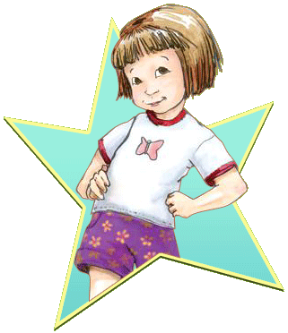
Chapter 1
Beezus and her little sister
Beezus and ramona go to the library. And check out a book.The last two weeks it was time to give it back and ramona colored all over the book .Beezus told the libraryian she had to pay for it. She got to keep it.

Slide 3

Chapter 2
Beezus and her Imagination
Beezus had in art class.Ramona walked in and disobead beezus.
Ramona ruined beezus ‘s afternoon.

Slide 4
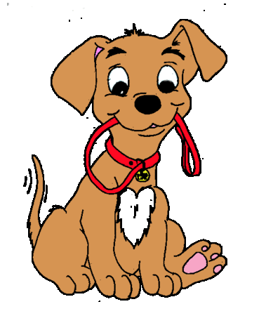
Chapter 3
Ramona and Risby
Beezus had a friend over his name was henry he brang his dog. Ramona locked the dog in the bathroom . And they got the dog out.

Slide 5



Chapter 4
Ramona and the apples
Ramona had to be watched by Beezus. Beezus had an idea she ran to get a book when she came back ramona was gone. Beezus found her in the basement eating apples.

Slide 6

Chapter 5
A party at the quimbys
Mother and Beezus were cleaning the house. Ramona said I,m having a party. Then the door bell rang it was kids they had a fun party then mother finally saw their parents.

Slide 7

Chapter 6
Beezuss birthday
Beezuss mom was making a cake . Ramona ruined it. Then her aunt was there they fixed the cake and father was home and they all celabrated the party even ramona.

