Slide 1
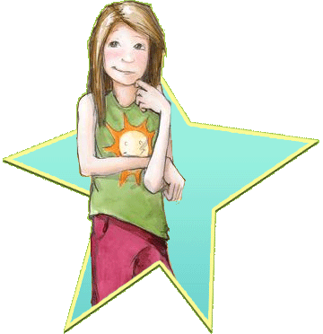
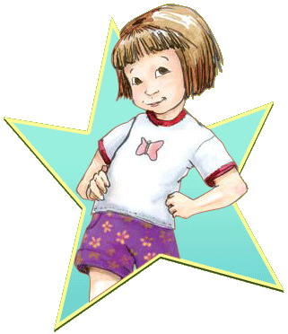
Beezus and Ramona
By Beverly Cleary
Presentation by Hunter Kirk

Slide 2
Chapter 1
Beezus is 9 years old, and her 4 year old sister Ramona is a nuisance.Ramona is always annoying. Beezus is the one who gets in trouble.

Slide 3
Chapter 2
Beezus is mad at Ramona. Miss. Robbins likes Ramona imagination. Beezus was mad.

Slide 4
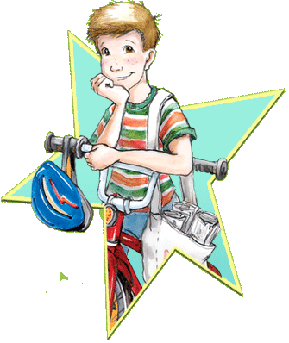
Chapter 3
Beezus gets to have Henry over. Ramona is mad because she doesn’t get to have a friend over. Ramona weeps and weeps and her mom sent her to her room.

Slide 5
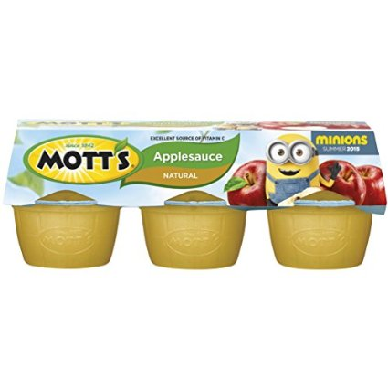
Chapter 4
While Beezus was watching Ramona she hid in the basement. Ramona took one bit out of each apple. Instead of punishing Ramona they ignored her while making applesauce.

Slide 6
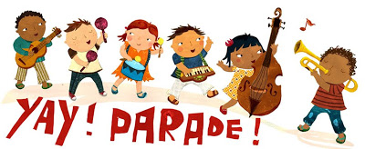
Chapter 5
Ramona had a party that no one knew about. Ramona got mad because no played with her toys. Bofore everyone went home they had applesauce and fig Newtons.

Slide 7
Chapter 6
It was Beezus birthday. Aunt Beatrice is coming for dinner. Beezus decides she loves Ramona very much ,and that she isn’t that bad.

