Slide 1
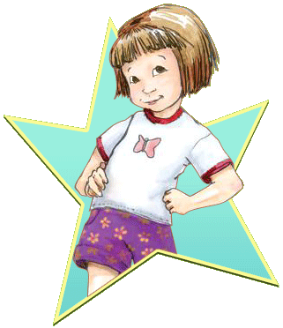
Ramona the Pest
By Beverly Cleary
Presentation by Hayden Garrett

Slide 2

Chapter 1
Ramona’s Great Day
Beezus and Mary Jane walked
Ramoma to school and Ramona
through a big fit .The girls from the school looked old fashion . Ramona hated a kid the kid hated her .

Slide 3
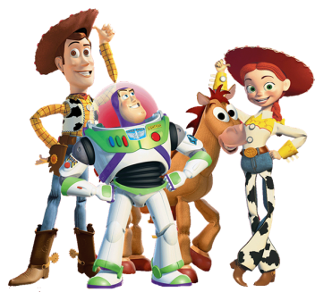

Chapter 2
Show And Tell
Ramona’s friend’s where having lunch at Ramona’s house.
Miss. Binney’s beautful bow choped
In two pieces.
A rabbit was chewing on it’s tail.

Slide 4
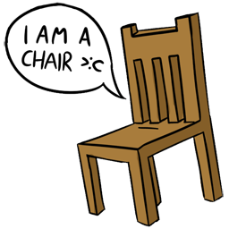
Chapter 3
Seat Work
Ramona took a eracer and scrubed something. Romona would never let anybody kiss her. Ramona got confused
On a lot of things.

Slide 5

Chapter 4
The Substitute
Ramona loved her teacher.
A girl named Susan drew a picture
Of a house. Davy said uh Miss. Binney’s coming.

Slide 6
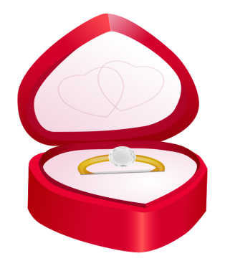
Chapter 5
Ramona’s Engagement Ring
Ramona took a eraser and scrubed
Something. Ramona would never let
Anybody kiss her. Ramona got confusd on a lot of things.

Slide 7
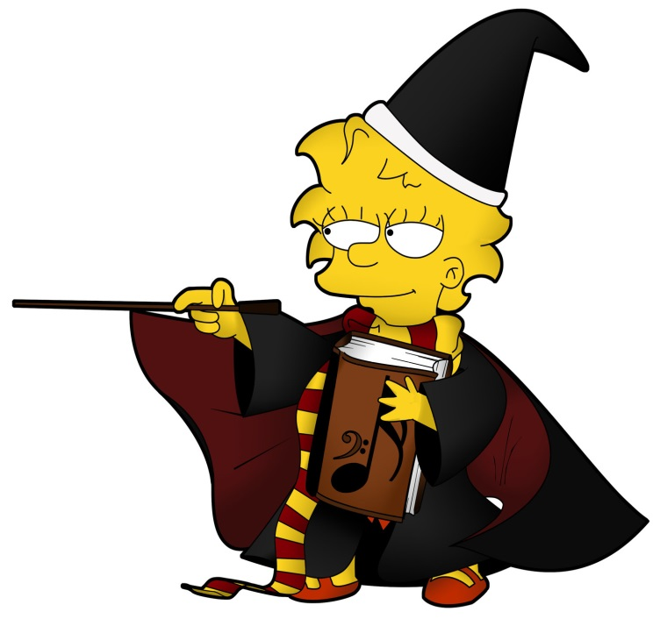
Chapter 6
A Wicked Witch
Ramona loved Halloween she liked
To drees up.
Ramona woke up and found two paper
Bags on her bed. Ramona’s whole class was scared of something

Slide 8

Chapter 7
The Thing That Went Wrong
Ramona’s day was off to a promising start for two reasons.
Ramona had a loose tooth she was scared. Miss. Binney smiled and smiled then stoped.

Slide 9

Chapter 8
Kindergarden Dropout
Ramona sang the dawnzer lee light .
Suddenly everything that happened to was to much for Ramona. Ramona wanted to be wicked really wicked

