Slide 1
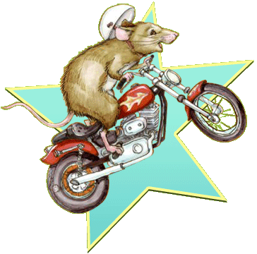
RUNAWAY RALPH
By Beverly Cleary
Presentation by Ethan McElravy

Slide 2
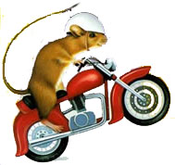
Chapter 1
We learned about a mouse named Ralph.
Ralphs family thought he was selfish.
Hearing the bugle made Ralph run away.

Slide 3

Chapter 2
We learned about a dog named Sam.
We met a gopher.
Ralph went to summer camp.

Slide 4

Chapter 3
Ralph got caught in a net.
Ralph got out of the hole.
Ralph is locked in a cage.

Slide 5

Chapter 4
Ralph stared to explore his new home. We learned about a mouse named Chum. Chum told Ralph a story.

Slide 6
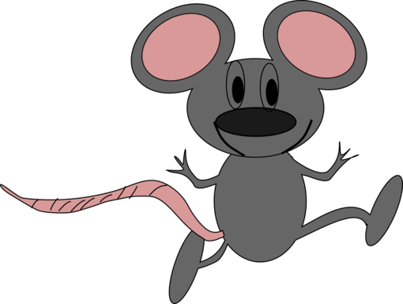
Chapter 5
Chum is chewing the bars of his cage.
Chum told Ralph to think about life.
Garf put a sign above Ralphs cage.

Slide 7
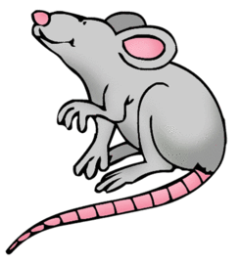
Chapter 6
Ralph thinks Catso is annoying.
There is a new camper named Karen.
Aunt Jill is telling the campers bad news.

Slide 8

Chapter 7
Ralph is trying to escape his cage.
Ralph is talking to a human.
Ralph escapes his cage.

Slide 9

Chapter 8
The campers found out that Ralph was gone. Ralph found the watch.
Garf found Ralph.

Slide 10

Chapter 9
Ralph and Garf are making a plan.
They have their plan.Ralph will go back home.

