Slide 1
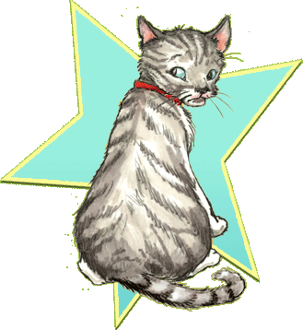
Socks
byBeverly Cleary
Presentation by Daniel

Slide 2
Chapter 1
The kitten sale
George the younger
Brother got Shoved
By His Younger Sister. DEBBIE AND GEORGE EXCHANGE A LOOK. DEBBIE AND GEORGE SAID MOMMY LOOK.

Slide 3
Chapter 2
The brickers Other Pet.
The Brickers Had a baby.
Socks felt leftout and sad.
Sock was happy because he got milk.

Slide 4
Chapter 3
Socks and the formula
The brickers had vistors.
Socks felt leftout so he got scared hid,andtook a nap. Then he woke up ,and got mad. Then socks stole a hot dog and got in trouble.

Slide 5
Chapter 4
THE EVENING THE SISTER CAME
Socks was put on a diet.
Socks was waking through the neiborhood begging for food.
Socks real I said that he wanted love.

Slide 6
CHAPTER 5
A VISIT FROM ANNA
SOCKS WENT TO THE BABY SITTER.
SOCKS BIT CHARLES BECAUSE HE STEPED ON HIM.
SOCKSWAS PUT OUTSIDE WHILE FEEDING THE BABY.

Slide 7
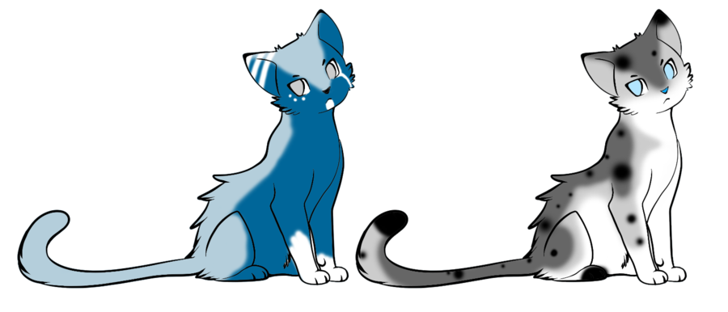
CHAPTER 6
OLD TAYLOR
SOCKS WAS ROLLING IN THE GARDEN THAT MR. BRICK WAS MAKING.
LATER SOCKS WAS HURT FROM A FIGHT FROM A BLACK CAT. THE BRICKERS STARTED TO LOVE SOCKS.

Slide 8
CHAPTER 7
SOCKS AND CHARLES
SOCKS WAS BACK IN HIS SPOT.
THE MOM WAS TIERD SO SHE LAIED DOWN ON THE COUCH. LATER SOCKS AND THE BABY GOT LOCKED IN THE ROOM. LATER MOM SAVED THEM CAT SAID I HAVE A FRIEND THIS I BELONG.

