Slide 1
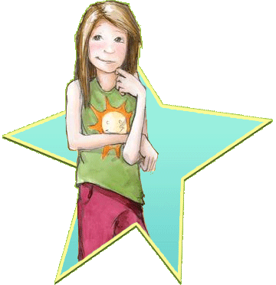
Beezus And Ramona
By Beverly Cleary
Presentation by Ciara Turner

Slide 2
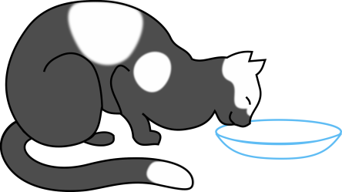
Beezus and her little sister
Ramona is really crazy. Ramona makes Beezus read a book. Beezus goes to the library with Ramona.

Slide 3
Beezus and her imagination
Ramona has an imagination about a lot of stuff . Beezus wants some of Ramona’s imagination. Ramona starts walking with a string.

Slide 4
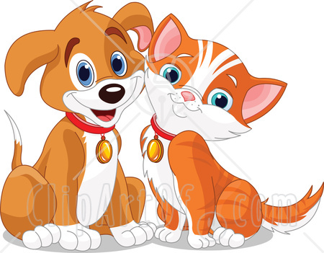
Ramona and Risby
Ramona locks Ribsy in the bathroom. Henry and Beezus are having fun but Ramona won’t leave them alone. Ramona is being bad when they are playing checkers.

Slide 5
Ramona and the apples
Beezus mother came in all happy and said babysit your sister. Ramona hides apples under her bed. Ramona was changing her clothes and she disappeared.

Slide 6
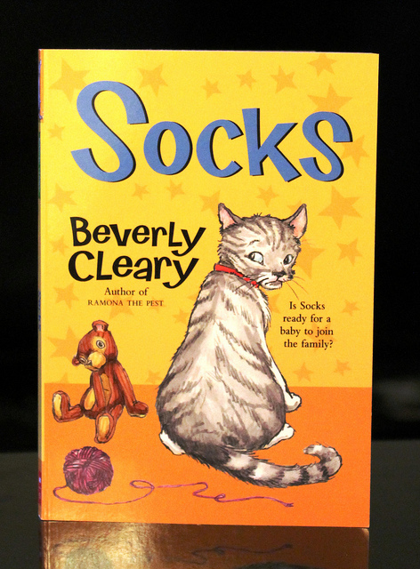
A party at the Quimby’s
Beezus is going to have a birthday party. Mrs. Kemp has a son named Howie and Beezus said it won’t be so quiet now. Ramona plans a party and her mom does not know.

Slide 7
Beezus and her birthday
Ramona put all the eggs shells and all. Ramona baked her rubber doll in Beezus’ cake. They have a party and Beezus eats cake.

