Slide 1
Socks
By Beverly Cleary
Presentation by Brody Harrison

Slide 2
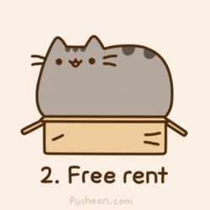
Chapter 1 The kitten sale
Deibbie and her brother had a Kiten sale.A family came and wanted socks.
George hid socks in a mail box.

Slide 3
Chapter 2 brickers other pet
The brikers have socks.it,s not the life he wanted but it wold do.The brikers had a babby .Now what.

Slide 4
CHAPTER 3 THE FORMULA
The Brickers family and friends came over to see baby chariles.Socks was teased and ignored .

Slide 5
Chapter 4 the sitter
Socks is hungry.He wonders around the neighbor hood looking for food.Mrs.Risly comes to baby sit. Socks loves her.

Slide 6
Chapter 5 nana
Nana comes to visit.she hates socks.He gets kicked OUT!!!

Slide 7
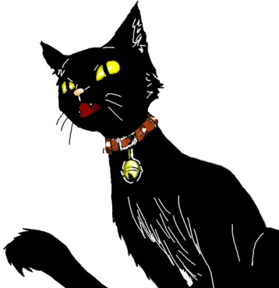
CHAPTER 6 OLD TAYLER
SOCKS IS SLEEPING.He got in a fight with Old tayler

Slide 8
Chapter 7 socks and charles
Socks is back in.He macks frinds with the baby. He is happy now.

