Slide 1
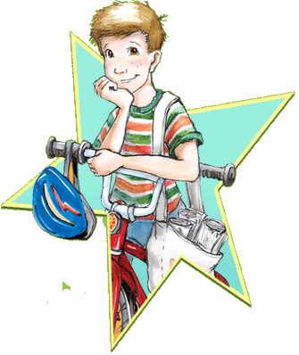
Henry and Beezus
By Beverly Cleary
Presentation by Bradlee

Slide 2
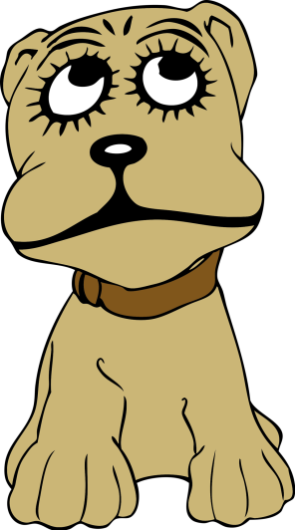
Chapter 1
Henry and Beezus is a peace of trouble. Henry is friends with Beezus. Henry will get the bike.

Slide 3

Chapter 2
Henry got some steak. Henry says O.K. scoot. Mother cut gum out of her hair.

Slide 4
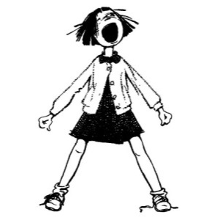
Chapter 3
Ribsy gets lots. Ribsy is not found yet. Ribsy is found.

Slide 5

Chapter 4
Henry wanted a bike. Henry did not want to take his friend. Henry got told he looked like his dad.

Slide 6

Chapter 5
Ramona won’t eat the ephants out of the animal crackers. Many of the people didn’t aution seriously. Henry got a bike for 4.04.

Slide 7

Chapter 6
Beezus is going to twirl Beezus boton. Scooter knows a lot about bikes. Their bike will have three wheels.

Slide 8

Chapter 7
Henry is in the prande. Henry is going to eat. Henry is eating his food

